Slide 1

Road Accident Severity Insigth & Hotspot Prediction
Abhishek Pattir (01)
Mudit Gupta (13)

Slide 2
Objectievs
In this mini project we achieved 5 objectives:
- Loading and cleaning of dataset.
- Analyze the impact of different weather conditions.
- Compare accident severity between weekdays and weekends.
- Identify top 10 accident hotspot cities using geospatial clustering.

Slide 3
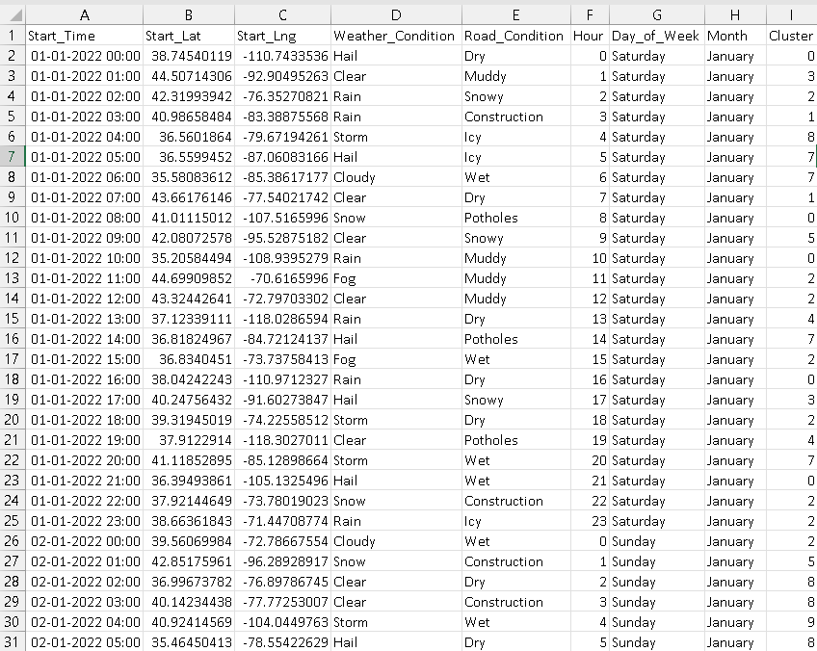
Loading and cleaning of dataset.
We used a synthetic dataset as the original dataset was having approx. 3000 entries in which approx. 2600 entries of cities were unknown.

Slide 4
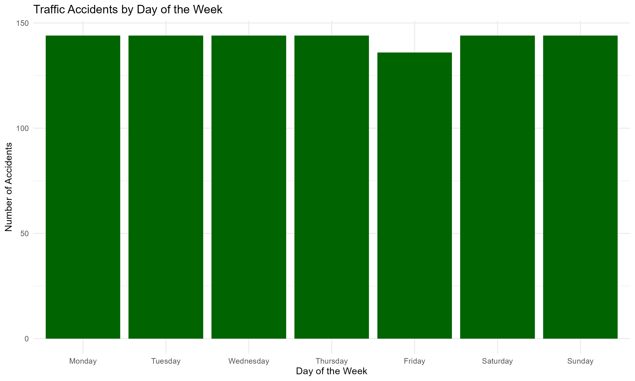
Compare accident severity between weekdays and weekends.
We created a bar plot of Day of the Week vs Number of Accidents which tells us that at which day of the

Slide 5
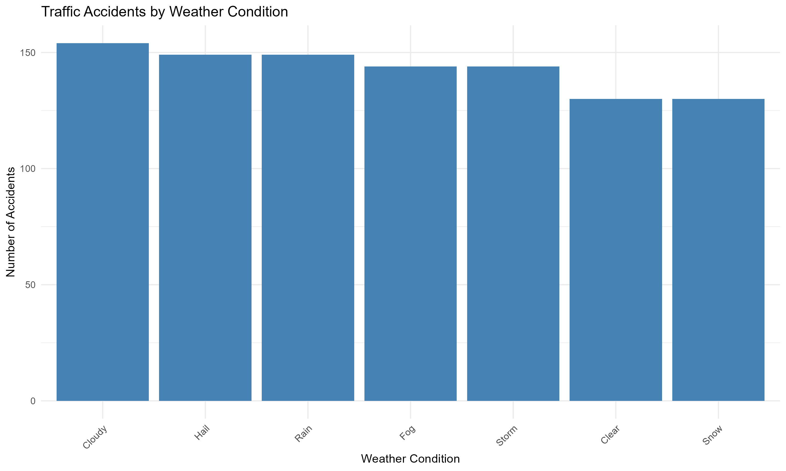
Analyze the impact of different weather conditions .
We created a bar plot of Number of Accidents vs Weather Condition which tells us that at what weather condition the accident frequency is high.

Slide 6
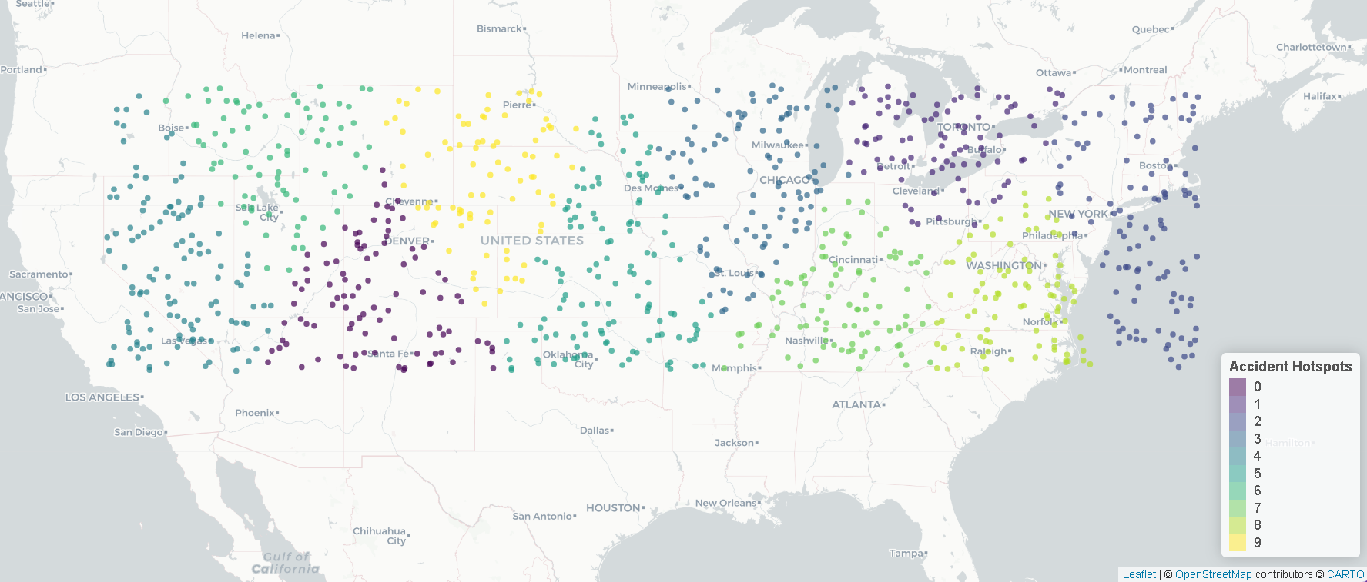
Identify top 10 accident hotspot cities using geospatial clustering.
We use leaflet a JS library which is helps to directly create interactive maps in R/Rstudio directly.

